Slide 1

MIS 281N
Data Management
Class 3 – Designing a Database
Brad Poynter
Clint Tuttle

Slide 2
1) Log into server 2) Goals today
1st part:
SQL vs NoSQL vs…NewSQL
Aggregating & Multi-table selects
Debrief
Break
2nd part:
Subqueries & Functions for different datatypes
Debrief

Slide 3
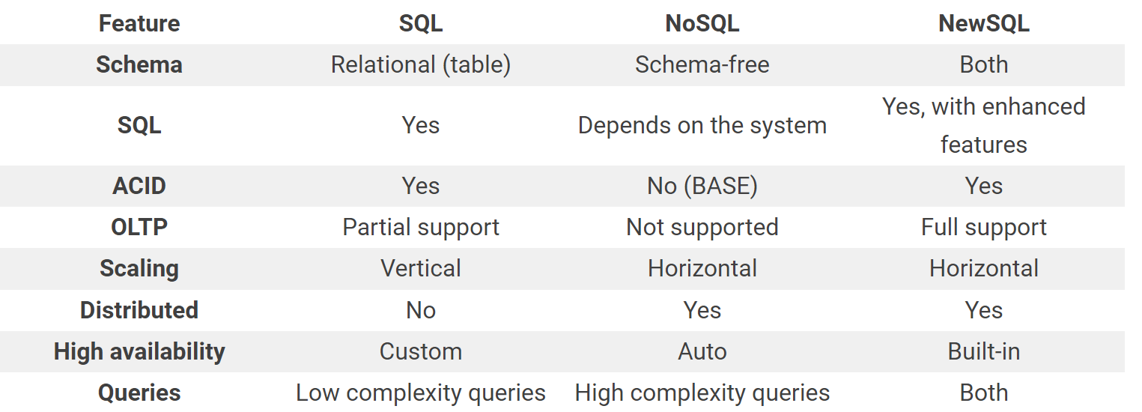
SQL vs NoSQL
vs…NewSQL
NewSQL is a modern relational database system that bridges the gap between SQL and NoSQL. NewSQL databases aim to scale and stay consistent.
Examples:
VoltDB
CockroachDB
NuoDB
ClustrixDB

Slide 4
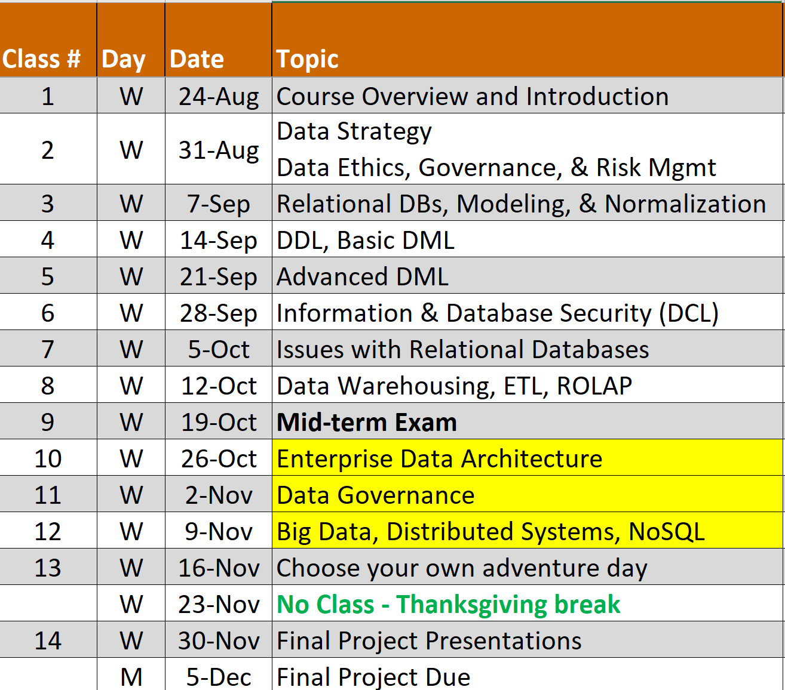
Coming up…

Slide 5
AGGREGATING

Slide 6
Basic SELECT clauses
SELECT Columns - Column names
- Arithmetic expressions
- Literals (text or numeric)
- Scalar functions
FROM Table or View names
WHERE Conditions (qualifies rows) – i.e. filters rows
ORDER BY Sorts result rows

Slide 7
New verbs to allow aggregating
SELECT Columns - Column names
- Arithmetic expressions
- Literals (text or numeric)
- Scalar functions
- “Aggregate” functions
FROM Table or View names
WHERE Conditions (qualifies rows) – i.e. filters rows
GROUP BY Creates sub totals in conjunction with column functions
HAVING Conditions for sub totals – i.e. filters aggregates/groups
ORDER BY Sorts result rows

Slide 8
Key tips for Grouping
If you only have aggregate columns in SELECT you do not need GROUP BY. e.g. select count(*) from table
If you have both non-aggregate and aggregate columns in SELECT, you DO need GROUP by
ORA-00979: not a GROUP BY expression

Slide 9
Window Function Types
Aggregate
SUM
MIN
MAX
COUNT
AVG
Ranking
ROW_NUMBER
RANK
DENSE_RANK
NTILE
Distribution/Analytic
CUME_DIST
FIRST_VALUE
LAST_VALUE
LAG
LEAD
PERCENTILE_CONT
PERCENTILE_DISC
PERCENT_RANK

Slide 10
Window Function Components
Function
Name
SUM(revenue)
OVER(
PARTITION BY ID
ORDER BY Month
ROWS BETWEEN
2 PRECEDING
AND CURRENT ROW
)
Partition Clause
Window
Definition
Order Clause
Frame Clause
Running 3 Month Sum

Slide 11
Practice followed by Q&A

Slide 12
MULTI-TABLE (Joins, Union, Minus)

Slide 13
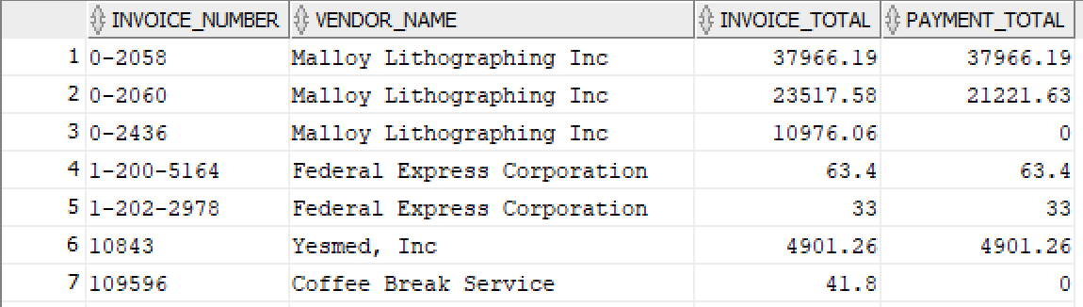
The explicit syntax for an inner join (2 tables only)
SELECT column_list
FROM table_1 <JOIN TYPE> JOIN table_2
ON join_condition_1
NOTE: The “join_condition” defines what columns connect the tables (e.g. table1.pk = table1.fk)
A SELECT statement that joins two tables
SELECT invoice_number, vendor_name, invoice_total, payment_total
FROM vendors INNER JOIN invoices
ON vendors.vendor_id = invoices.vendor_id
ORDER BY invoice_number
The result set

Slide 14

Using a table alias
SELECT column_list
FROM table_1 n1 INNER JOIN table_2 n2
ON n1.column_name operator n2.column_name
A SELECT statement that joins two tables
SELECT invoice_number, vendor_name, invoice_total, payment_total, vendor_id
FROM vendors v INNER JOIN invoices i
ON v.vendor_id = i.vendor_id
ORDER BY invoice_number
ORA-00918: column ambiguously defined
00918. 00000 - "column ambiguously defined"
SELECT invoice_number, vendor_name, invoice_total, payment_total, v.vendor_id
FROM vendors v INNER JOIN invoices i
ON v.vendor_id = i.vendor_id
ORDER BY invoice_number

Slide 15
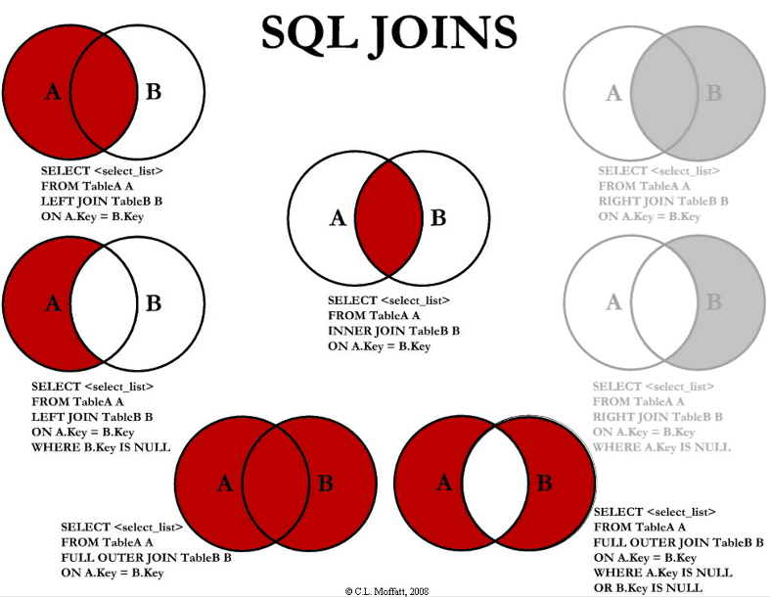
Join Types
INNER
LEFT
FULL OUTER
Don’t need RIGHT

Slide 16
Joining more than 2 tables
SELECT column_list
FROM table_1 n1 INNER JOIN table_2 n2 ON n1.column_name operator n2.column_name
INNER JOIN table_3 n3 ON n2.column_name = n3.column_name
e.g. Joining 2+ tables with aliases
SELECT i.invoice_number, v.vendor_name, i.invoice_total, i.payment_total
FROM vendors v INNER JOIN invoices i ON v.vendor_id = i.vendor_id
INNER JOIN invoice_line_items ili ON i.invoice_id = ili.invoice_id
ORDER BY invoice_number

Slide 17
Key tips for Joins
Start with Inner and then switch to LEFT or FULL OUTER if you need non-matches

Slide 18
UNION

Slide 19
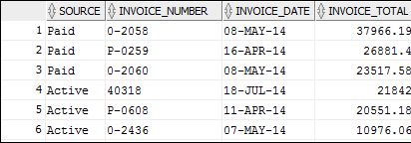

Slide 21
Practice followed by Q&A

Slide 22
SUBQUERIES (in WHERE and FROM only)

Slide 23
What is a subquery?
Sometime the logic needed in a SELECT statement requires another SELECT statement – this second SELECT statement is called a subquery
The syntax for a subquery is the same as the syntax for the SELECT statement
A subquery can return a single value, a result set that contain a single column, or a result set that contains one or more columns
The first SELECT statement is called the outer query

Slide 24
4 ways to use a subquery in a SELECT statement
In a WHERE clause as a search condition
In a HAVING clause as a search condition
In the FROM clause as a table specification
In the SELECT clause as a column specification

Slide 25
Subqueries can be part of …
… a WHERE clause as a search condition
Single value or list of values
… the FROM clause as a table specification
When a subquery returns a result set with two or more columns, it can be used in a FROM clause
A subquery coded in a FROM clause is called an inline view
An inline view should have an alias
All calculated values should have a name (alias)
Inline views are not as efficient as views

Slide 26
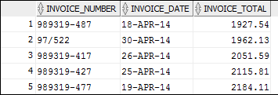
Basic use case: Use a Subquery in the WHERE clause
Part 1: Write subquery
SELECT AVG(invoice_total)
FROM invoices
Value returned by query
1879.7413
Part 2. Use query as a subquery in a WHERE clause
SELECT *
FROM invoices
WHERE invoice_total >
(SELECT AVG(invoice_total)
FROM invoices)
ORDER BY invoice_total
The result set

Slide 27
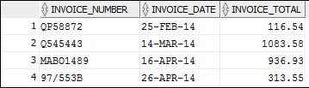
Advantages of joins
A join can include columns from both tables.
A join is more intuitive when it uses an existing relationship.
Advantages of subqueries
A subquery can pass an aggregate value to the outer query.
A subquery is more intuitive when it uses an ad hoc relationship.
Long, complex queries can be easier to code with subqueries.

Slide 28
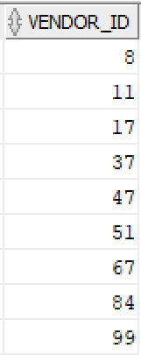
Build first query
Final Query w/ Subquery
SELECT *
from invoices
WHERE vendor_id IN (
SELECT vendor_id
FROM vendors
where vendor_name like ‘B%’)
SELECT vendor_id
FROM vendors
where vendor_name like 'B%'
Subquery Results
Same as the following
SELECT *
from invoices
WHERE vendor_id IN (8,11,17,37,47,51,67,84,99)

Slide 29
Practice followed by Q&A

Slide 30
Functions (for different data)

Slide 31
Practice followed by Q&A

Slide 32
Questions?

Slide 33
Questions?

